Slide 1
Optimize Data Usage when Using Microsoft Graph with Query Parameters

Slide 2

Overview
Microsoft Graph Overview
Accessing the Microsoft Graph
Manipulate Responses with Query Parameters
Control the Amount of Information Returned in Queries
Manipulate the Order and Format Data is Returned

Slide 3
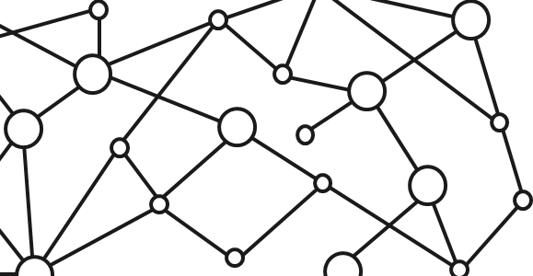
Microsoft 365 Platform
Extend Microsoft 365 experiences
web, device, and service apps
Build your experience
Documents
Pages
Conversations
Timeline
iOS/Android/Windows/Web
1
Microsoft Graph
Notes:
Our Office 365 developer vision focuses on the Users’ experience and their data. As a developer you can bring your applications into their user experience. With over 1.2+ billion users of Office worldwide, this is a huge opportunity to provide a window into your applications. As well as being able to connect into their data and add intelligence to your applications. There are currently 850 million events created a month and a total of 470Pb+ of data stored in the service that can add value to for our Users’.

Slide 4
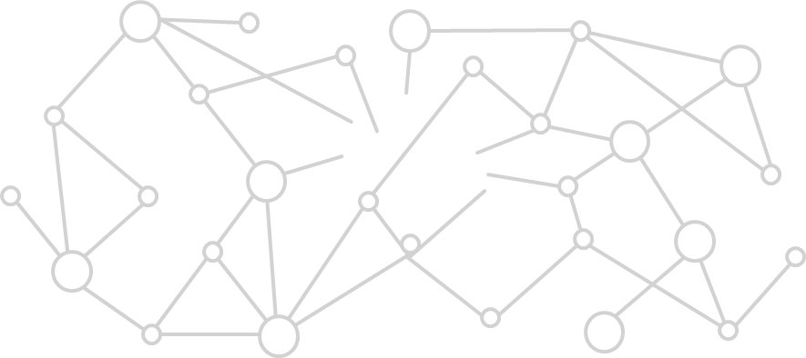
Microsoft Graph Gateway to your data in the Microsoft-cloud
https://graph.microsoft.com
Office 365
Windows 10
Enterprise Mobility + Security
Users, Groups, Organizations
Outlook
SharePoint
OneDrive
Teams
Planner
Excel
OneNote
Activities
Device Relay
Commands
Notifications
Azure AD
Intune
Identity Manager
Advanced Threat Analytics
Advanced Threat Protection
Mail, Calendar,
Contacts and Tasks
Sites and Lists
Drives and Files
Channels, Messages
Tasks and Plans
Spreadsheets
Notes, and more…
Identity Management
Access Control
Synchronization
Domains
Administrative Units
Applications and Devices
Advanced Threat Analytics
Advanced Threat Protection
Alerts
Policies
and more…
Notes:
Microsoft Graph is the gateway to your data in the Microsoft Cloud as you can see from the list of resources, services and entities at the bottom of the slide, there are a lot of things we can take advantage of in the Microsoft 365 platform. We can work with mail, calendar, contacts, tasks in addition to content inside of SharePoint sites and lists, files inside of OneDrive, interact with Microsoft Teams and many more things we can take advantage of.
Each of these services typically has it’s own API that we can leverage to read and write to these different services. However it can be challenging and cumbersome to work with these different services as each has implemented their own endpoint, permission model, syntax for performing some operations like searching and other subtleties. Each endpoint is also secured with Azure AD which means that developers will need to authenticate with Azure AD and obtain an OAuth access token for each service they want to work with.
The Microsoft Graph addresses many of these challenges by acting as a proxy to a lot of these different services. It encompasses data residing in Office 365 such as mail, calendar, contacts and OneDrive as well as many others. In addition, it also provides access to Windows 10 and Enterprise Mobility + Security under a single endpoint. This endpoint, https://graph.microsoft.com, allows developers to create applications that will only have to authenticate once and obtain a single access token that can be used to retrieve data from multiple sources, greatly simplifying the development process.
Each service will sill have their individual permissions, or scopes, but all these permissions are defined in a single place under the Microsoft Graph endpoint, and it handles the underlying calls and permission requests to each of these different endpoints.

Slide 5
Microsoft Graph, gateway to Microsoft 365
Single resource that proxies multiple Microsoft services
Simplifies token acquisition and management
Eliminates the need to traditional discovery (using “me” and “myorganization”)
Allows for easy traversal of objects and relationships
Notes:
As the previous slide stated, the Microsoft Graph is your gateway to all data in Microsoft 365. It is a single resource that proxies multiple Microsoft services.
Because the Microsoft Graph acts as a proxy endpoint to multiple endpoints for each Microsoft 365 service, it will simplify the process of obtaining OAuth access tokens that you must include with each request to one of these endpoints. Unlike the process of obtaining a different token for each endpoint, the Microsoft Graph enables you to obtain a single access token to submit requests that can retrieve data from all the services and endpoints the Microsoft Graph exposes.
One of the other challenges we used to have with these different services was determining the endpoint URL for each service as some were unique per user. To address this, Microsoft created a directory service that you could query to determine what the URL was for the different services. However, the Microsoft Graph greatly simplifies this for you with two special endpoints. The /me and /myorganization endpoints will take you to the root of your user entity or your organization in the Microsoft Graph.
This module will explain how you can easily find relationships between entities in the Microsoft Graph and traverse these objects to find related content. Using the /me and /myorganization endpoint in combination with the ability to traverse related entities, the Microsoft Graph makes it easy to access your data.

Slide 6
Accessing the Microsoft Graph
Direct REST API
Any platform
Any language
Any framework
Native SDKs
Utilize framework & platform specific implementations
Abstracts the details of constructing & processing REST requests over HTTP
.NET, iOS, Android, PhP, Ruby, JavaScript, etc.
Notes:
Developers can create all sorts of applications that will communicate with the Microsoft Graph. To support as many developers and platforms as possible, the Microsoft Graph has two options for developers to choose from when integrating the Microsoft Graph into their applications.
At its core, the Microsoft Graph is a REST API. This means that developers can use any platform, any framework and any programming language they are most comfortable with. The only requirement is that they can issue common HTTP requests and process HTTP responses, which all recent platforms, frameworks and languages can do.
In addition, the Microsoft Graph also provides multiple native SDKs for developers who want to leverage a rich programming model within their applications. These SDKs are available for multiple platforms and simplify the process of interacting with the Microsoft Graph’s REST API, abstracting away the tasks of constructing, submitting and processing the REST requests and responses with the Microsoft Graph REST API.
You will likely find an existing SDK for the platform and language you are working on as you’ll find all the popular platforms covered, including .NET, iOS, Android, Java, PhP, Ruby, JavaScript and many more.

Slide 7
Authentication Options
Azure AD only
Separate auth flow supports Azure AD accounts only
Azure AD and Microsoft Accounts
Converged auth flow supports Azure AD accounts and Microsoft accounts (LiveID - hotmail.com, etc.)
Notes:
The Microsoft Graph supports two styles of authentication. One option supports users to authenticate using either an Azure AD account, also known as a Work & School account, or a Microsoft Account. The former account is typically used to access content and resources within Office 365 and Microsoft 365. The latter account type, a Microsoft Account, is used to access consumer resources such as OneDrive Consumer, Outlook.com and other related services.

Slide 8
Microsoft Account + Azure AD
Many apps want to sign users in from both Microsoft account and Azure AD
Single endpoint, OpenID Connect and OAuth 2.0
Single SDK
Single end user sign in experience
Single app registration experience
Works with Microsoft Graph
Single API endpoint, business and consumer data
Notes:
What’s nice about the Microsoft Graph supporting both styles of authentication, is that the same API and endpoints can be used to create applications that will expose business data in Microsoft 365 or consumer data within Microsoft’s consumer services. This makes it easy for developers to learn a single API and have the ability to configure their application to support both business and consumer data that is driven strictly by the user and what type of account they login with.

Slide 9
Manipulate Microsoft Graph with Query Parameters
Microsoft Graph’s REST API supports optional query parameters
Query parameters are used to specify and control the amount of data returned in a response
Each endpoint exposed via the Microsoft Graph has varying support for different query parameters
Most of the query parameters defined in the OData v4 query language specification
Combine query parameters just like typical query string parameters: separate them with &
For example, to just get a count of users instead of all users, use the $count query parameter
https://graph.microsoft.com/v1.0/me/contacts?$count=true
Notes:
Microsoft Graph’s REST API confirms to the OData v4 protocol. One aspect of this is that the REST API supports many query parameters. These query parameters enable developers to specify & control the amount of data returned in the responses.
Each endpoint exposed by the Microsoft Graph has varying support for different query query parameters. For example, the $count query parameter is supported by the /contacts endpoint, but it isn’t supported for directory objects like users and groups.
Query parameters are added to the query string portion of a URL and have a $ prefix. Each parameter has a different syntax for usage. For example, the $count query parameter, when set to TRUE, will tell the Microsoft Graph to only report the number of items in the collection instead of returning all the data in the collection. This dramatically reduces the amount of data returned by the service, reducing the work on Microsoft Graph and bandwidth consumed by your application.

Slide 10
Control the Amount of Information Returned in Queries
One powerful use case for query parameters is limiting the amount of data returned
$top=5
Only return the first 5 records in the response
Useful in paging scenarios
$skip=5
Skip the first 5 records in the response
When combined with $top, useful in paging scenarios
e.g. page 3: https://graph.microsoft.com/v1.0/me/contacts?$top=5&$skip=5
$select=displayName,mail
Only return specific fields from the entity, not all fields in the response
Notes:
One of the most powerful uses of query parameters is to control how much data is returned in the response to a request.
The $top parameter enables you to limit the response to only include a specific number of records.
The $skip parameter enables you to skip the first # of results in the response.
You can combine the $top and $skip parameters to implement paging solutions. For example consider the scenario where you want to display 5 items at a time. Page 1 would only include $top=5 while page 2 would include $top=5&$skip=5 to skip the first 5 results that were shown on page 1, but get the next 5 records to display.
Microsoft Graph responses will include a set of default properties when no result set is defined. This means if you only want the display name & email address of a lot of users, you will actually receive a lot more data that isn’t going to be used. To optimize this request and speed up the response, you can use the $select parameter to specify a comma-delimited list of properties you want to receive in the response.

Slide 11
Manipulate the Order and Format Data is Returned
Query parameters can be used to control how the data is returned
$orderby=displayName
Control the sort order of the items returned from Microsoft Graph
$orderby=from/emailAddress/name desc, subject
Sort by complex types & combine values
$format=[json|atom|xml]
Control format of the data returned (default = JSON)
Notes:
Another powerful uses of query parameters is to control how the data is returned in the response to a request.
The $orderby parameter enables developers to let data from Microsoft Graph be pre-sorted. By default data is returned in ascending order, but you can add the “desc” keyword after the property to sort in descending order. It also supports sorting by multiple fields, separating each field with a comma.
Complex fields can also be sorted. Complex types, such as the from field in an email message is a complex type of an email address that contains a name & address property. To sort by name, use from/emailAddress/name.
By default, responses from Microsoft Graph are returned in the JSON format. However, you can request data in two other formats, ATOM & XML, by adding the $format parameter.

Slide 12
Demo

Slide 13
Thank you.

